Slide 2
develop understanding about the basics of coded inequalities,
analyze properties, conditions, and rules of coded inequalities,
solve various problems relating to coded inequalities and relations.

Slide 3

Basics
Equality
  ‘ = ’ – Equal
Inequality
  ‘ = ’ - Not Equal
  ‘ $>$ ’ - Greater than
  ‘ $<$ ’ - Less than
  ‘ $≥$ ’ - Greater than equals to
  ‘ $≤$ ’ - Less than equals to

Slide 4

Symbolic Representation
A = B
  A is equal to B.
A $>$ B
  B is less than A.
  A is greater than B.
A $<$ B
  B is greater than A.
  A is Less than B.

Slide 5
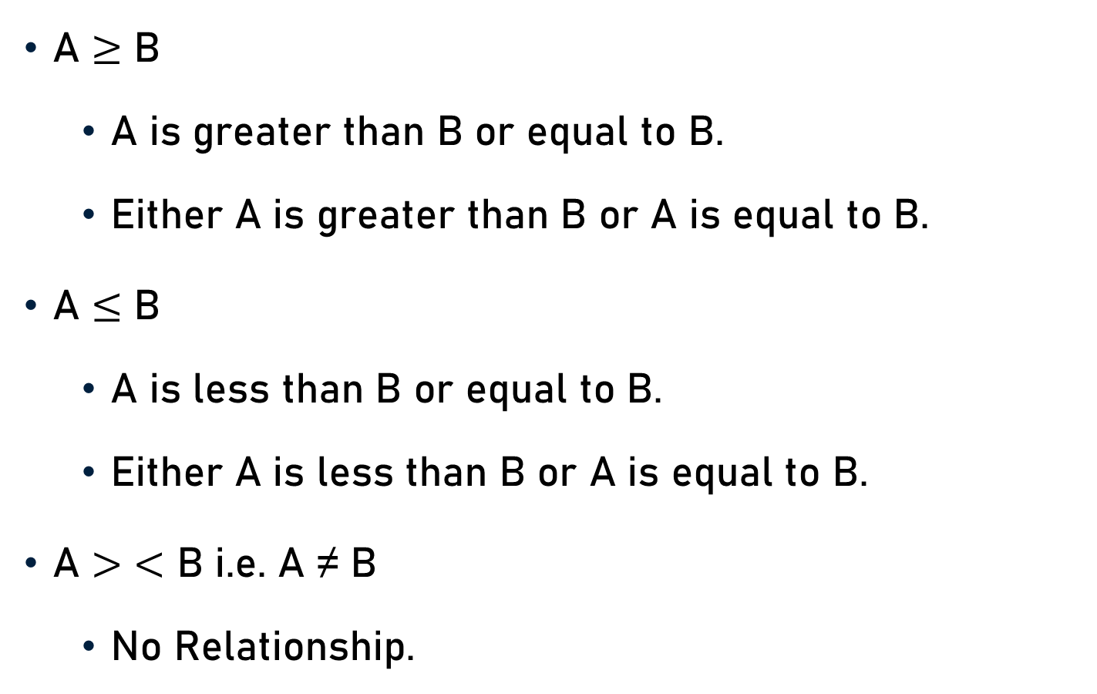
Symbolic Representation
A $≥$ B
  A is greater than B or equal to B.
  Either A is greater than B or A is equal to B.
A $≤$ B
  A is less than B or equal to B.
  Either A is less than B or A is equal to B.
A $>$ $<$ B i.e. A ≠ B
  No Relationship.

Slide 6
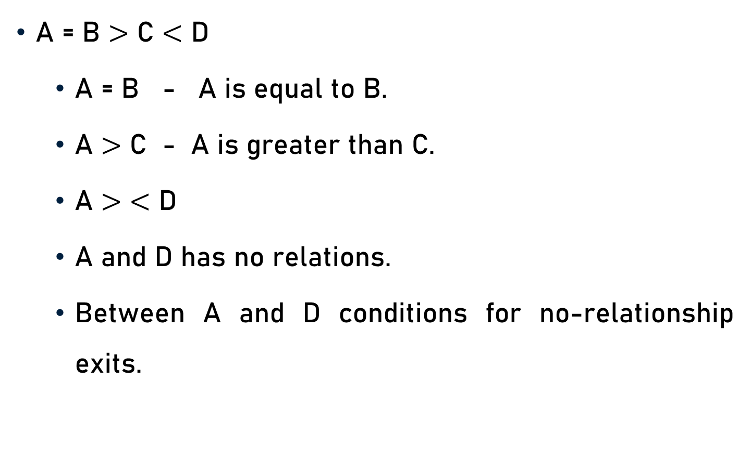
Example
A = B $>$ C $<$ D
  A = B - A is equal to B.
  A $>$ C - A is greater than C.
  A $>$ $<$ D
  A and D has no relations.
  Between A and D conditions for no-relationship exits.

Slide 7
Properties
Addition
  If a ≥ b, then a + c ≥ b + c
  If a ≤ b, then a + c ≤ b + c
Subtraction
  If a ≥ b, then a – c ≥ b – c
  If a ≤ b, then a – c ≤ b – c

Slide 8
Properties
Multiplication
  If a ≥ b, then ac ≥ bc, where c>0
  If a ≤ b, then ac ≤ bc, where c>0
Division
  If a ≥ b, then a/c ≥ b/c, where c>0
  If a ≤ b, then a/c ≤ b/c, where c>0

Slide 9
Properties
Transitivity
  If a ≤ b and b ≤ c then, a ≤ c
Inverse Additive
  If a ≥ b, then -a ≤ -b, if a>0, b>0
  If a ≤ b, then -a ≥ -b, if a>0, b>0

Slide 10
Properties
Inverse Multiplicative
  If a ≥ b, then 1/a ≤ 1/b, if a>0, b>0
  If a ≤ b, then 1/a ≥ 1/b, if a>0, b>0

Slide 11
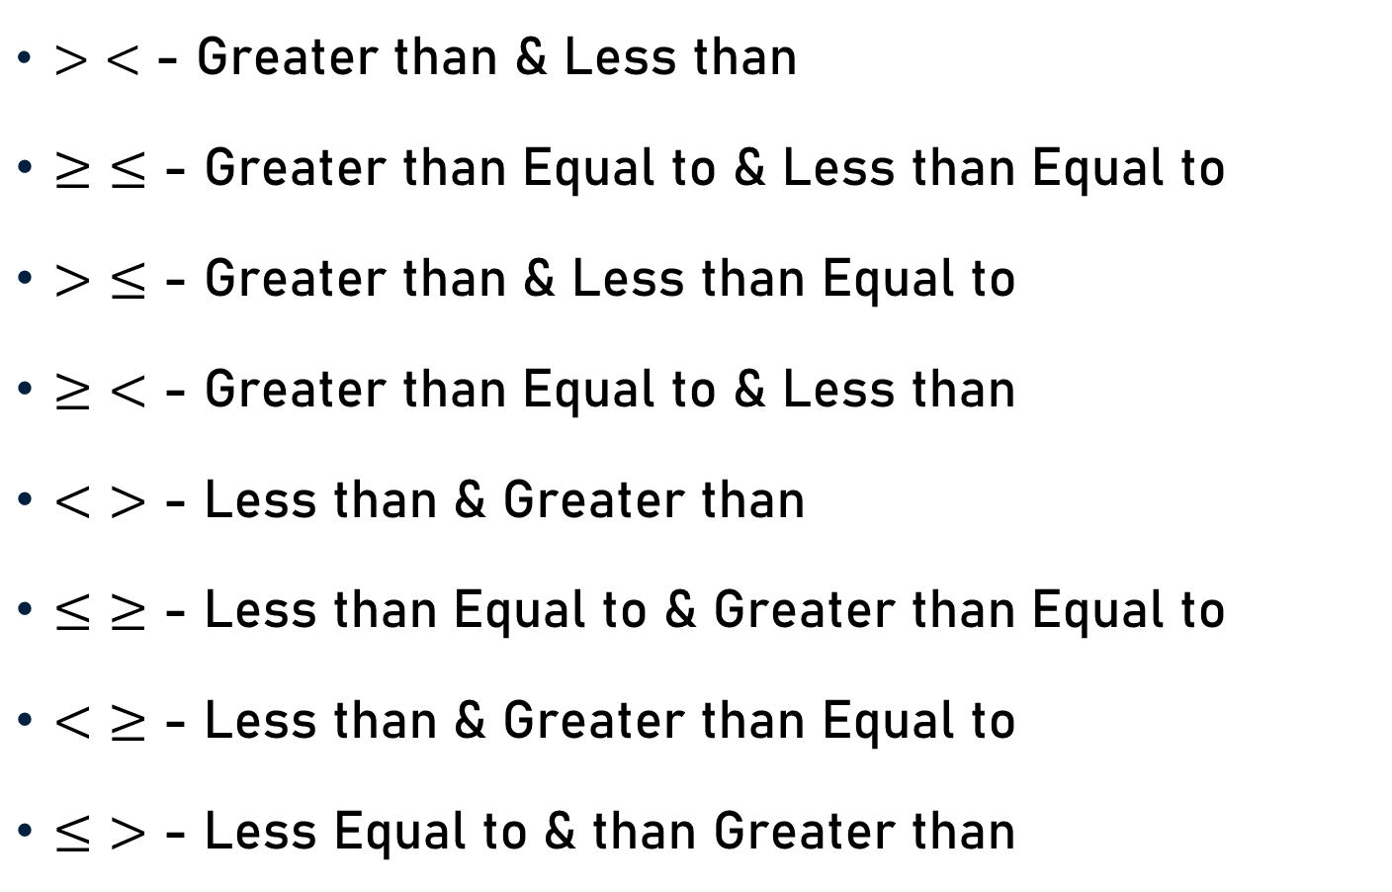
Conditions for No Relationship
$>$ $<$ - Greater than & Less than
$≥$ $≤$ - Greater than Equal to & Less than Equal to
$>$ $≤$ - Greater than & Less than Equal to
$≥$ $<$ - Greater than Equal to & Less than
$<$ $>$ - Less than & Greater than
$≤$ $≥$ - Less than Equal to & Greater than Equal to
$<$ $≥$ - Less than & Greater than Equal to
$≤$ $>$ - Less Equal to & than Greater than

Slide 12
Conditions – Combining Two Inequalities
Two Inequalities - Common Term
Definite Conclusion
  All Signs in Combined Inequality
  Pointing in Same Direction

Slide 13

Conditions – Combining Two Inequalities
Rule
  A $≤$B $≤$ C $≤$ D
    A = D, A $<$ D, and A $≤$ D
    A = C, A $<$ C, and A $≤$ C
    B = D, B $<$ D, and B $≤$ D

Slide 14

Conditions – Combining Two Inequalities
Rule
  A $≤$B$<$C $≤$ D
    A $<$ D and A = D
    B $<$ D and B = D
    A $<$ C and A = C

Slide 15

Conditions – Combining Two Inequalities
Rule
  A $≥$ B $≥$C$≥$ D
    A = D, A $>$D, and A$≥$ D
    A = C, A $>$C, and A $≥$C
    B = D, B $>$D, and B $≥$D

Slide 16

Conditions – Combining Two Inequalities
Rule
  A $≥$ B $≥$C $>$ D
    A = C, A $>$C, and A $≥$C
    A $>$ D and A = D
    B $>$ D and B = D

Slide 17
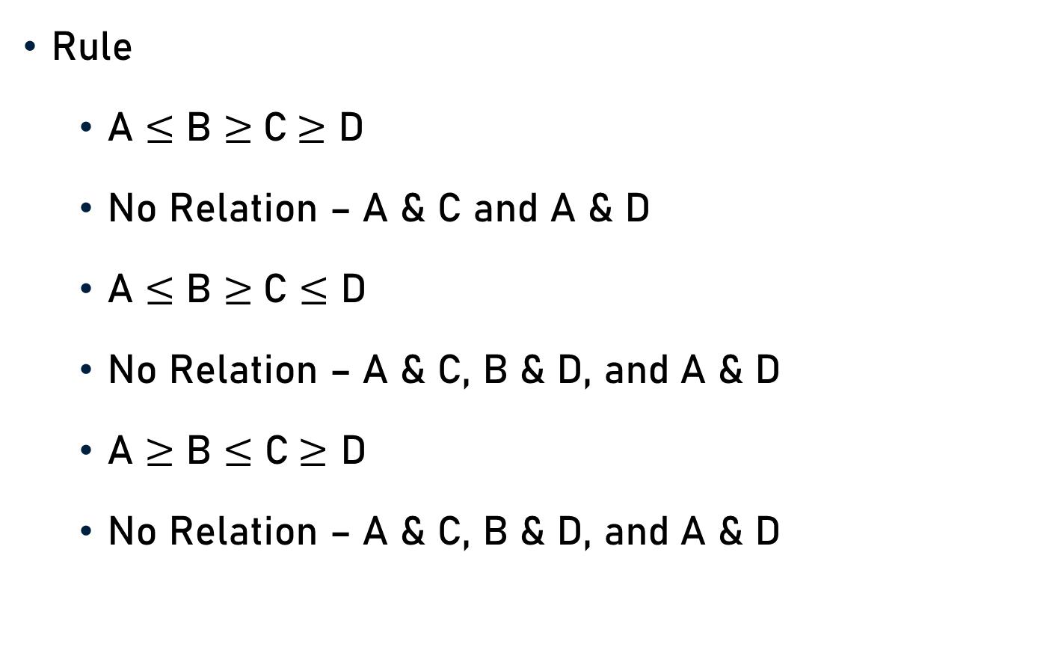
Conditions – Combining Two Inequalities
Rule
  A $≤$ B $≥$C$≥$ D
  No Relation – A & C and A & D
  A $≤$ B $≥$C $≤$ D
  No Relation – A & C, B & D, and A & D
  A $≥$ B $≤$ C$≥$ D
  No Relation – A & C, B & D, and A & D

Slide 18
Options
(a) If only conclusion I follows.
(b) If only conclusion II follows.
(c) If either conclusion I or II follows.
(d) If neither conclusion I nor II follows.
(e) If both conclusion I and II follow.

Slide 19
Problem 1
Statements
  Q = Z, C ≥ G , G ≥ Q, Q ≥ R
Conclusions
  I. G ≥ Z and II. C ≥ R
Explanation
  C ≥ G ≥ Q = Z ≥ R
  G ≥ Z (I follows)
  C ≥ R (II follows)

Slide 20
Problem 2
Statements
  L > U ≥ K, Z < U < R
Conclusions
  I. L > Z and II. K < R
Explanation
  L > U > Z or L > Z (I follows)
  K ≤ U < R or K < R (II follows)

Slide 21
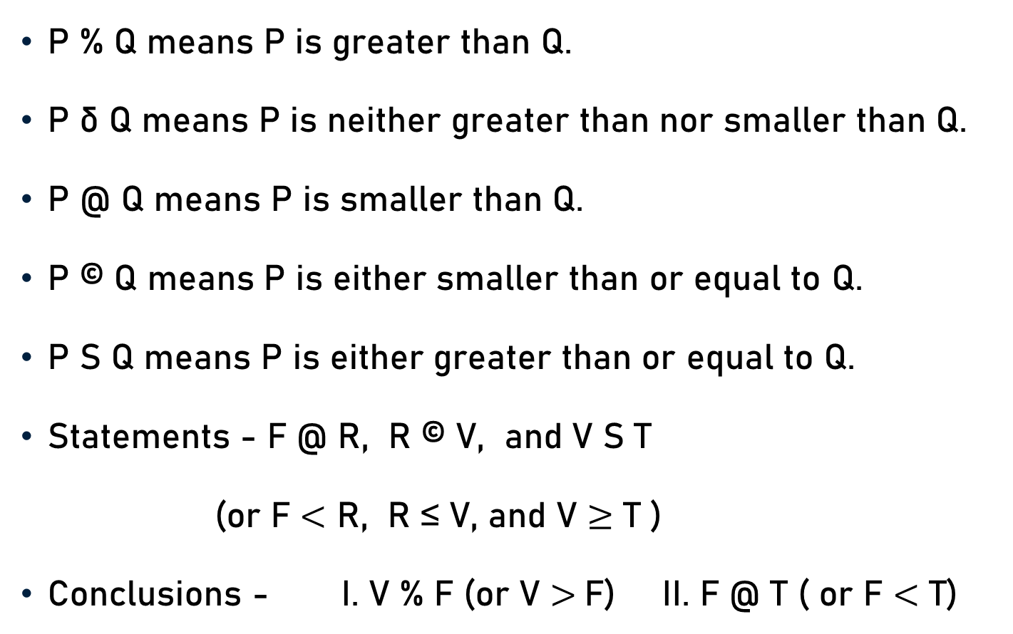
Problem 3
P % Q means P is greater than Q.
P δ Q means P is neither greater than nor smaller than Q.
P @ Q means P is smaller than Q.
P © Q means P is either smaller than or equal to Q.
P S Q means P is either greater than or equal to Q.
Statements - F @ R, R © V, and V S T
(or F $<$ R, R ≤ V, and V $≥$ T )
Conclusions - I. V % F (or V $>$F) II. F @ T ( or F $<$ T)

Slide 22
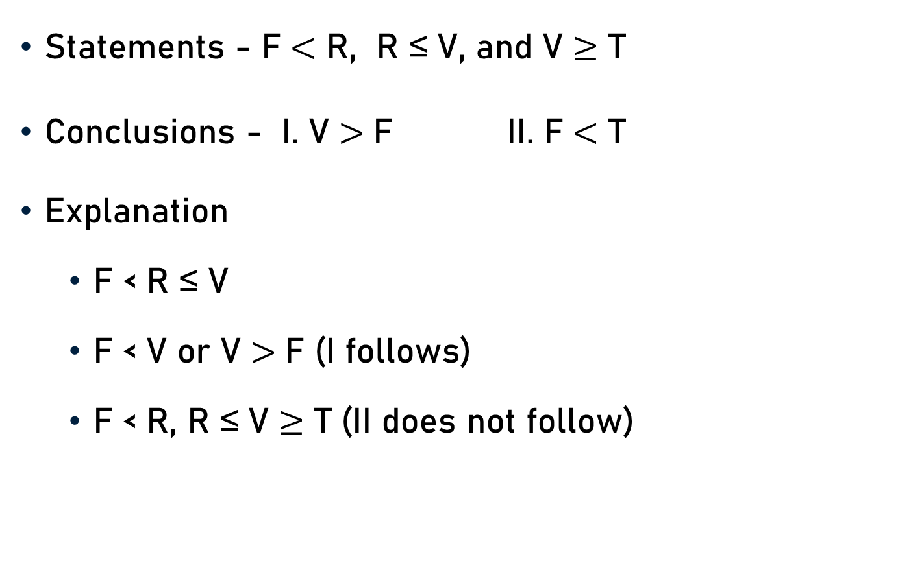
Problem 3
Statements - F $<$ R, R ≤ V, and V $≥$ T
Conclusions - I. V $>$F II. F $<$ T
Explanation
  F < R ≤ V
  F < V or V $>$F (I follows)
  F < R, R ≤ V $≥$ T (II does not follow)

Slide 23
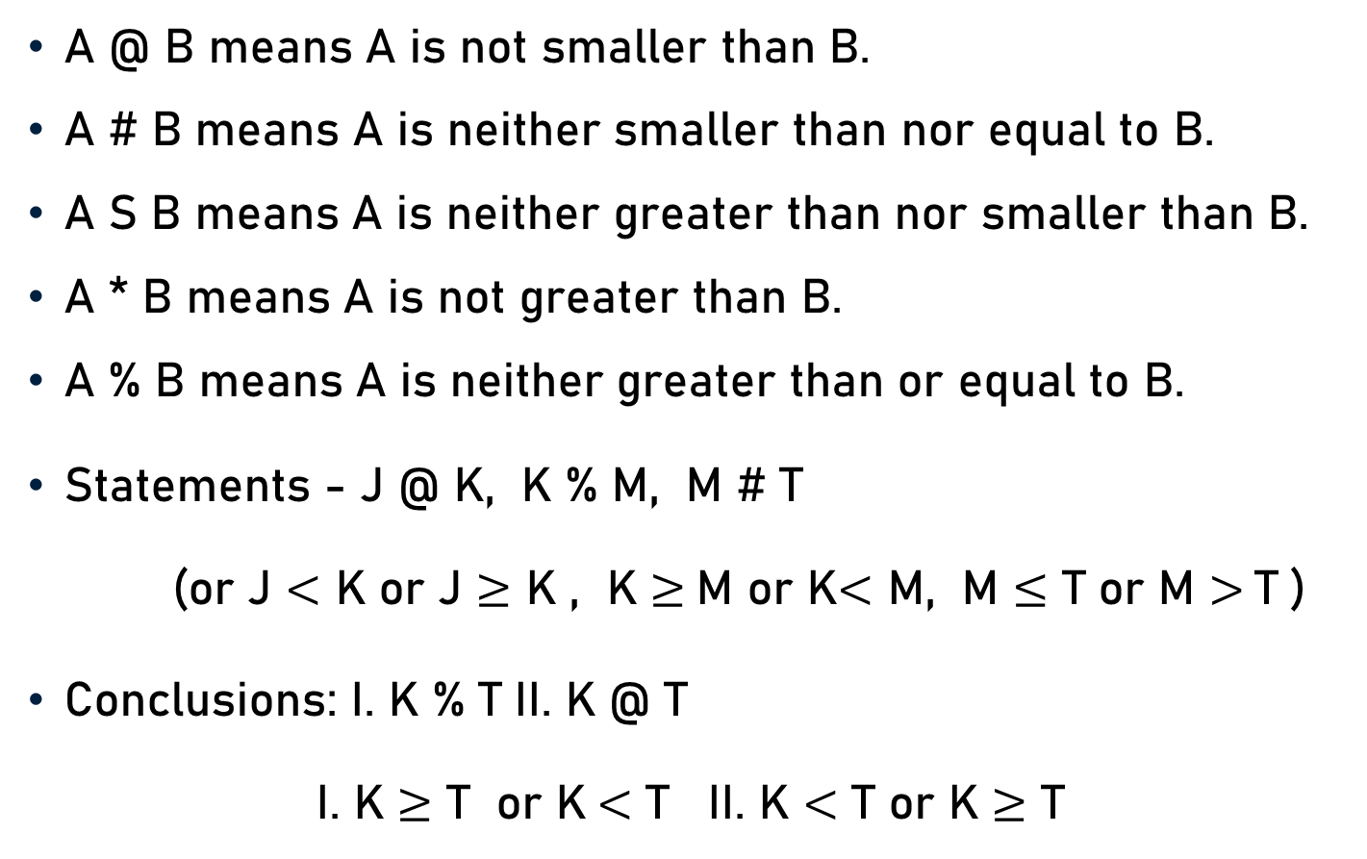
Problem 4
A @ B means A is not smaller than B.
A # B means A is neither smaller than nor equal to B.
A S B means A is neither greater than nor smaller than B.
A * B means A is not greater than B.
A % B means A is neither greater than or equal to B.
Statements - J @ K, K % M, M # T
  (or J $<$ K or J $≥$ K , K $≥$M or K$<$ M, M $≤$ T or M $>$T )
Conclusions: I. K % T II. K @ T
  I. K $≥$ T or K$<$ T II. K $<$ T or K $≥$ T

Slide 24

Problem 4
Statements –
J $≥$ K , K $<$ M, M $>$T
Conclusions-
I. K$<$ T and II. K $≥$ T
Explanation
  J $≥$ K $<$ M $>$T
  Either I (K$<$ T ) or II (K $≥$ T) must be true.

Slide 25
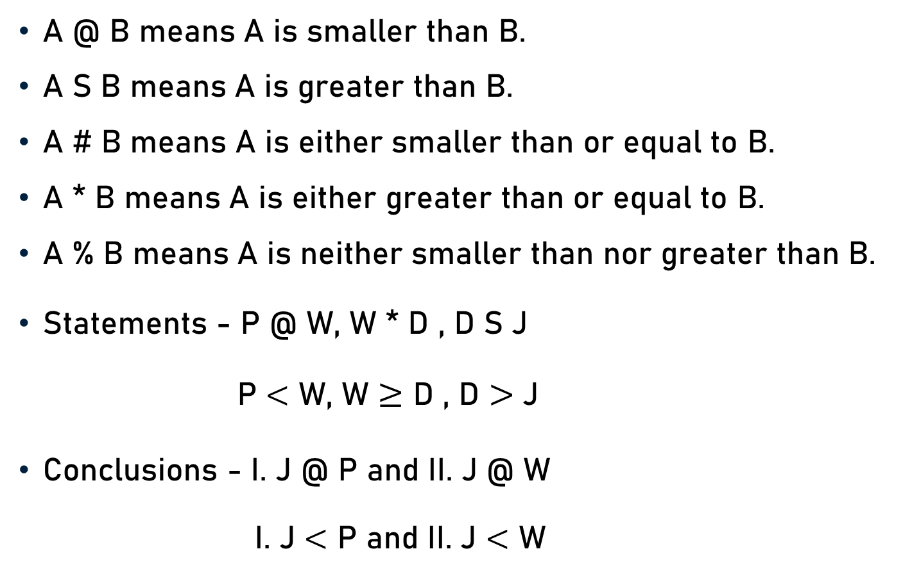
Problem 5
A @ B means A is smaller than B.
A S B means A is greater than B.
A # B means A is either smaller than or equal to B.
A * B means A is either greater than or equal to B.
A % B means A is neither smaller than nor greater than B.
Statements - P @ W, W * D , D S J
  P $<$ W, W $≥$ D , D $>$J
Conclusions - I. J @ P and II. J @ W
  I. J $<$ P and II. J $<$ W

Slide 26
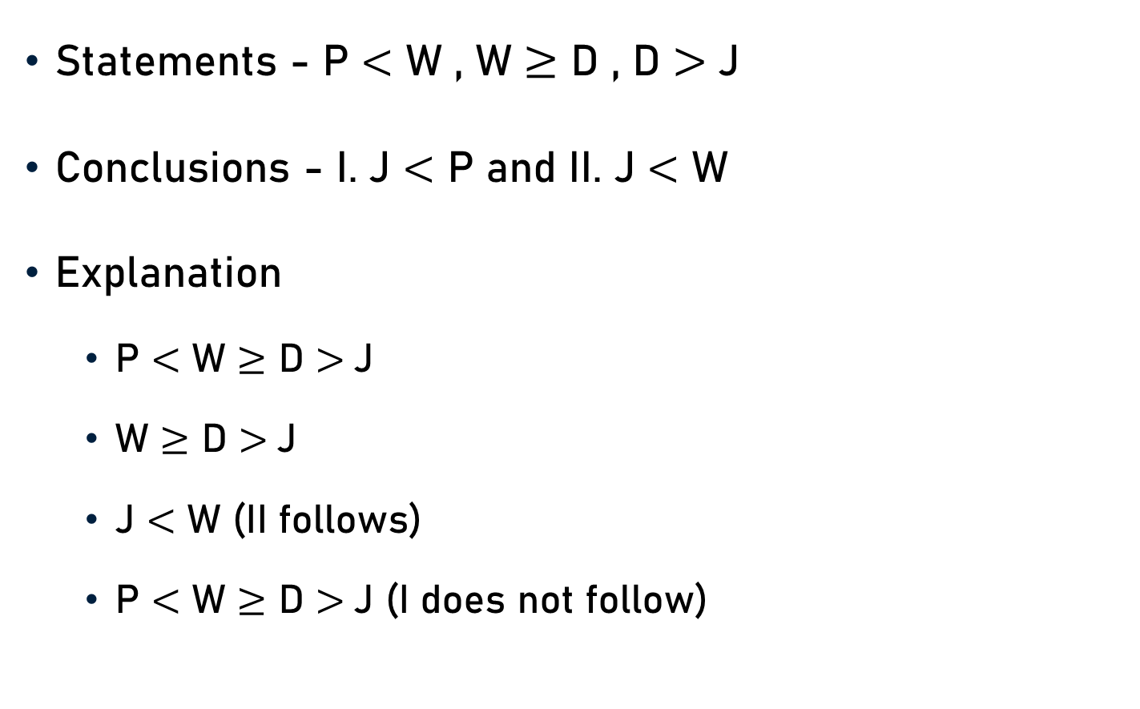
Problem 5
Statements - P $<$ W , W $≥$ D , D $>$J
Conclusions - I. J $<$ P and II. J $<$ W
Explanation
  P $<$ W $≥$ D $>$J
  W $≥$ D $>$J
  J $<$ W (II follows)
  P $<$ W $≥$ D $>$J (I does not follow)

Slide 27
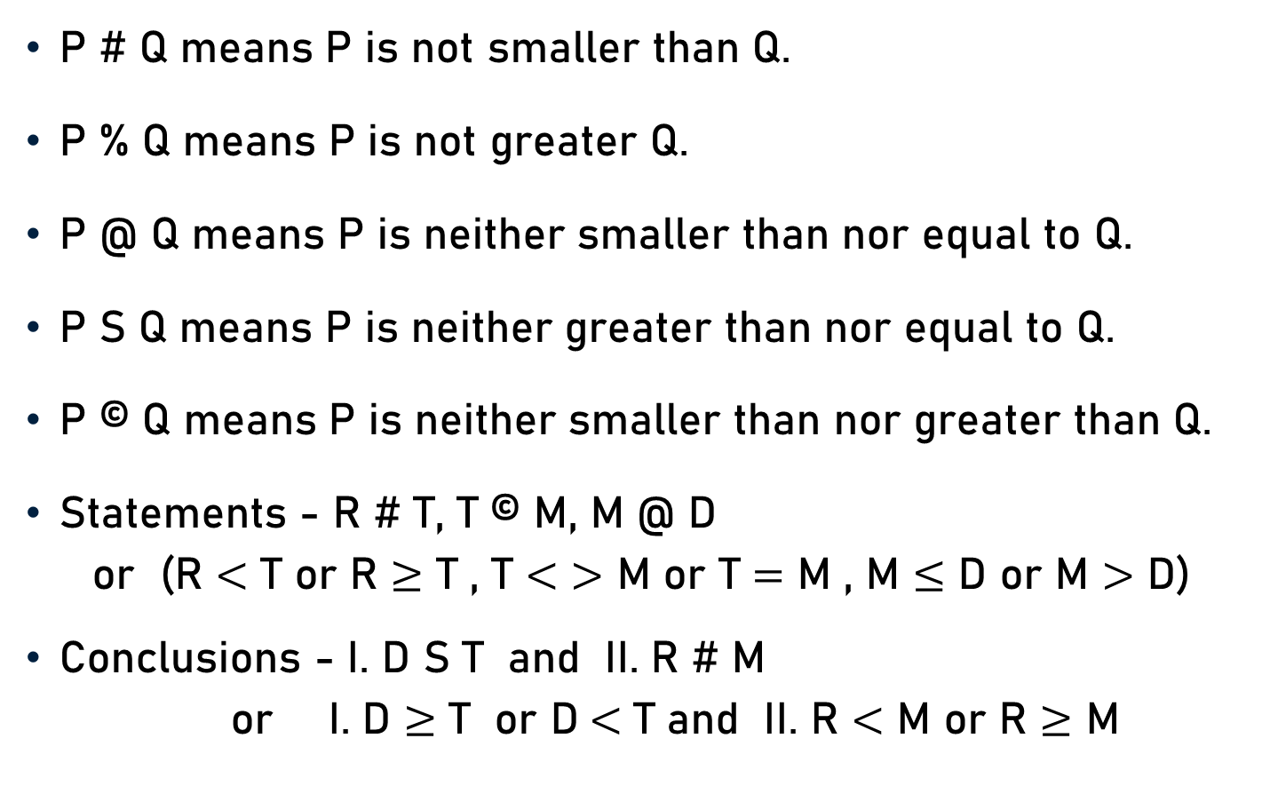
Problem 6
P # Q means P is not smaller than Q.
P % Q means P is not greater Q.
P @ Q means P is neither smaller than nor equal to Q.
P S Q means P is neither greater than nor equal to Q.
P © Q means P is neither smaller than nor greater than Q.
Statements - R # T, T © M, M @ D
  or (R $<$ T or R $≥$ T , T $<$ $>$ M or T $=$ M , M $≤$ D or M $>$ D)
Conclusions - I. D S T and II. R # M
  or I. D $≥$ T or D$<$ T and II. R $<$ M or R $≥$ M

Slide 28

Problem 6
Statements - R $≥$ T , T $=$ M , M $>$ D
Conclusions - I. D$<$ T and II. R $≥$ M
Explanation
  R $≥$ T $=$ M $>$ D
  T $>$ D or D $<$T (I follows)
  R $≥$ M (II follows)

Slide 29
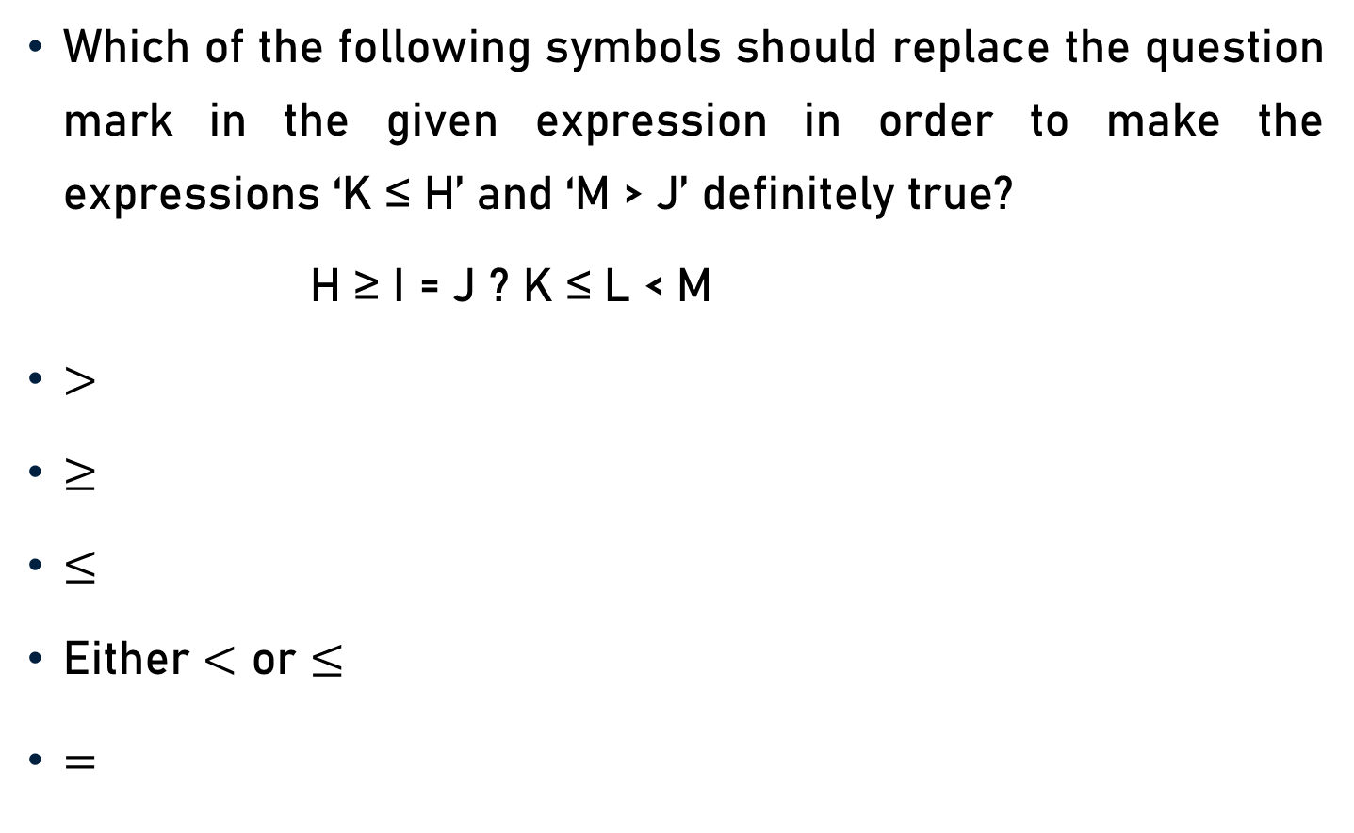
Problem 7
Which of the following symbols should replace the question mark in the given expression in order to make the expressions ‘K ≤ H’ and ‘M > J’ definitely true?
H ≥ I = J ? K ≤ L < M
$>$
$≥$
$≤$
Either $<$ or $≤$
$=$

Slide 30
Problem 7
K ≤ H and M > J
H ≥ I = J ? K ≤ L < M
Explanation
  H ≥ I = J = K ≤ L < M

Slide 31
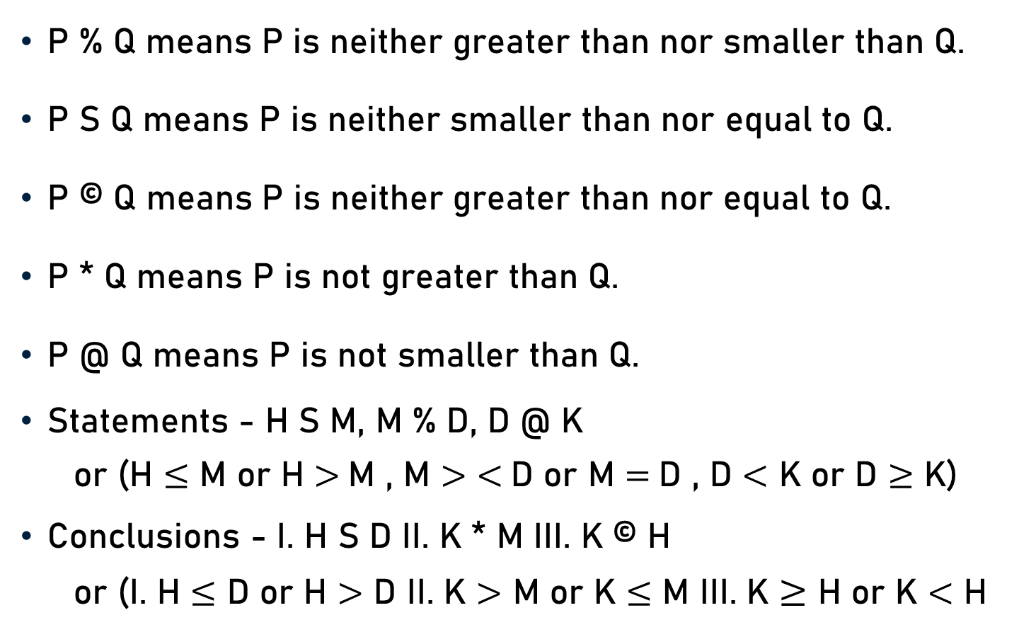
Problem 8
P % Q means P is neither greater than nor smaller than Q.
P S Q means P is neither smaller than nor equal to Q.
P © Q means P is neither greater than nor equal to Q.
P * Q means P is not greater than Q.
P @ Q means P is not smaller than Q.
Statements - H S M, M % D, D @ K
  or (H $≤$ M or H $>$M , M $>$ $<$D or M $=$D , D $<$ K or D $≥$ K)
Conclusions - I. H S D II. K * M III. K © H
  or (I. H $≤$ D or H $>$ D II. K $>$ M or K $≤$ M III. K $≥$ H or K $<$ H

Slide 32
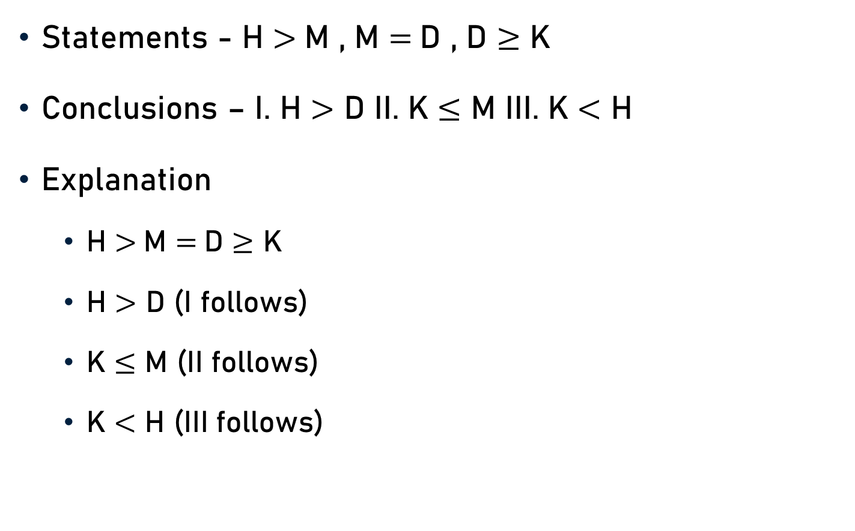
Problem 8
Statements - H $>$M , M $=$D , D $≥$ K
Conclusions – I. H $>$ D II. K $≤$ M III. K $<$ H
Explanation
  H $>$M $=$D $≥$ K
  H $>$ D (I follows)
  K $≤$ M (II follows)
  K $<$ H (III follows)

Slide 33

Conclusion
Coding Inequality
  ‘ = ’ - Not Equal
  ‘ $>$ ’ - Greater than
  ‘ $<$ ’ - Less than
  ‘ $≥$ ’ - Greater than equals to
  ‘ $≤$ ’ - Less than equals to

Slide 34
Summary
Coding Inequalities
  Basics
  Symbolic Representation
  Properties
  Conditions & Rules
  Problems - Coded Inequalities & Relations

